Slide 1

Hacking the Vote: A Step-by-Step Guide to Manipulating Voting Machines
By: Dennis Freyman

Slide 2
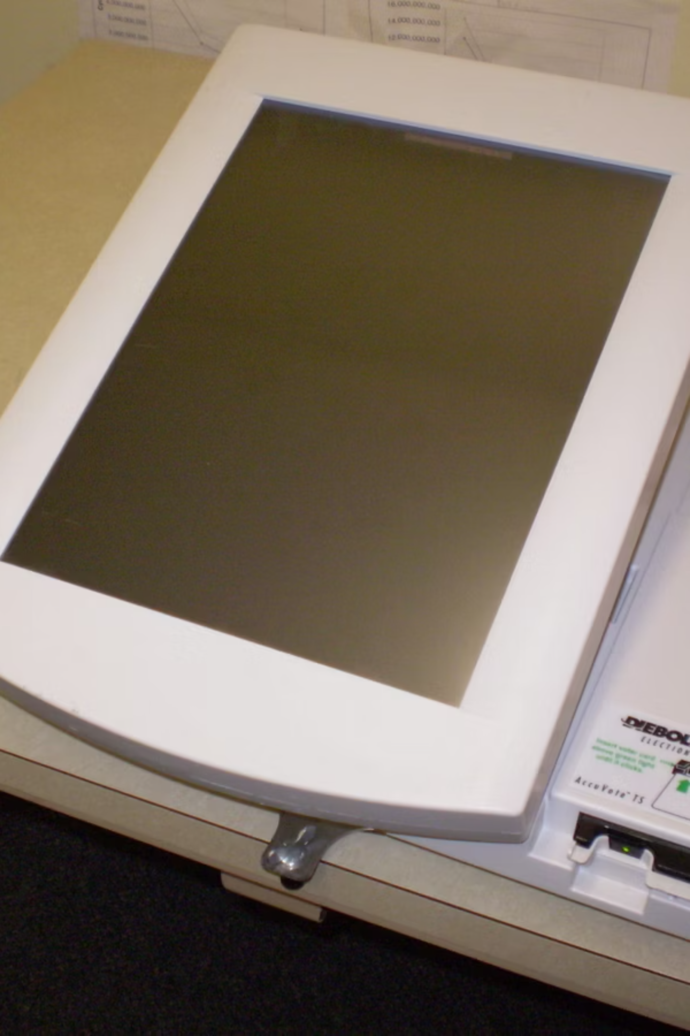


The Diebold AccuVote-TS
Introduced in the early 2000s, this Direct Recording Electronic (DRE) machine was widely used across the United States.
Vulnerabilities such as unencrypted data, weak physical security, and outdated software have been commonly found in this model.

Slide 3

Step 0 – Physical Access
Physical access is key for this model due to weak physical safeguards and the presence of exposed ports.
Polling Stations: The Diebold AccuVote-TS machines are often set up ahead of time and left unattended.
Storage Facilities: Machines are stored in less-secure locations before and after elections, increasing exposure to tampering.

Slide 4

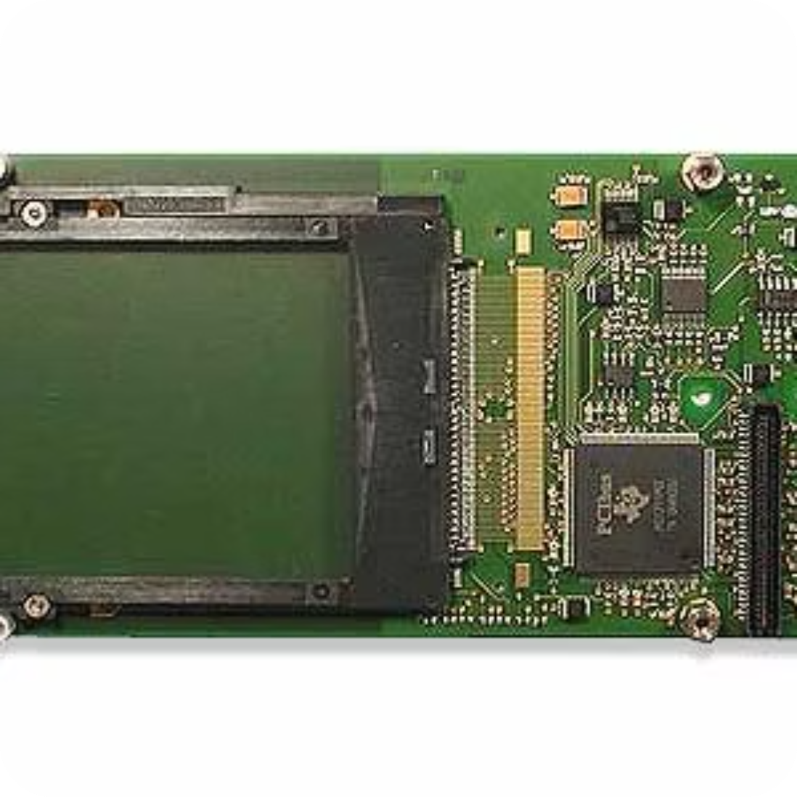
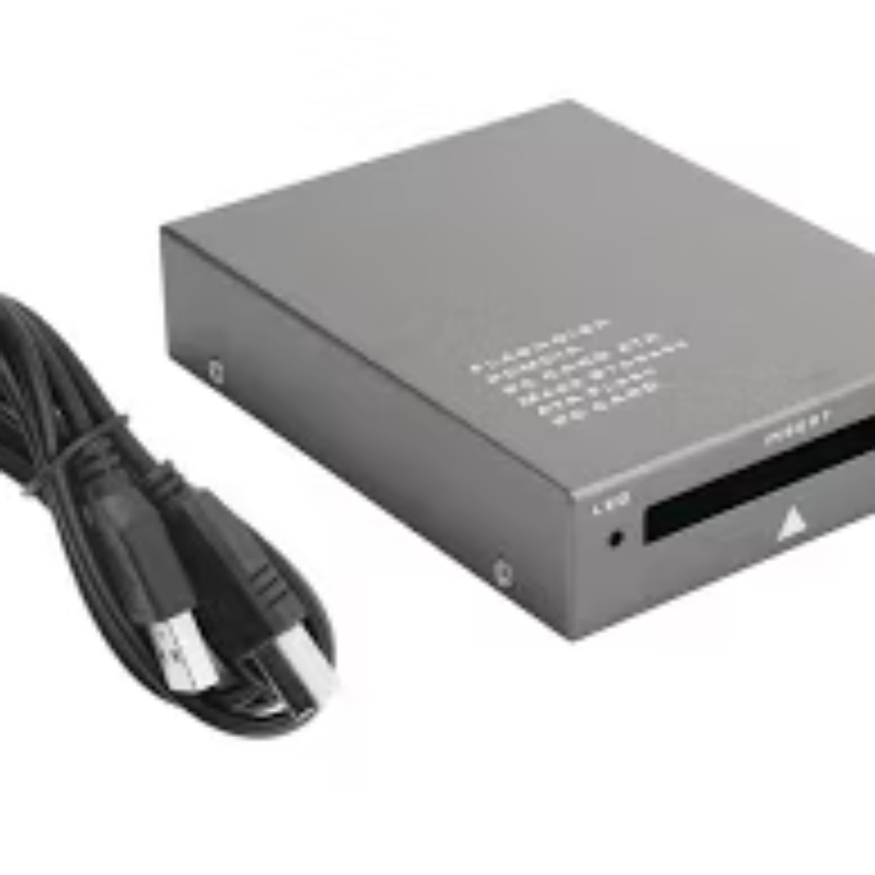
Step 0.1 – What needs to happen
The AccuVote-TS has an exposed PCMCIA memory card slot located inside a side panel that’s easily accessible.
The memory card stores election data, including vote counts and system files, and it is not encrypted.
An adversary can bring a reader to extract and read the data on the memory card or even write new data onto it.

Slide 5

Step 1: Identify Vulnerabilities
1. Insert the memory card into a PCMCIA card reader connected to a computer.
2. Use file-extraction software to copy the data, which includes firmware, configuration files, and vote tallies.
3. Open and edit the firmware files

Slide 6
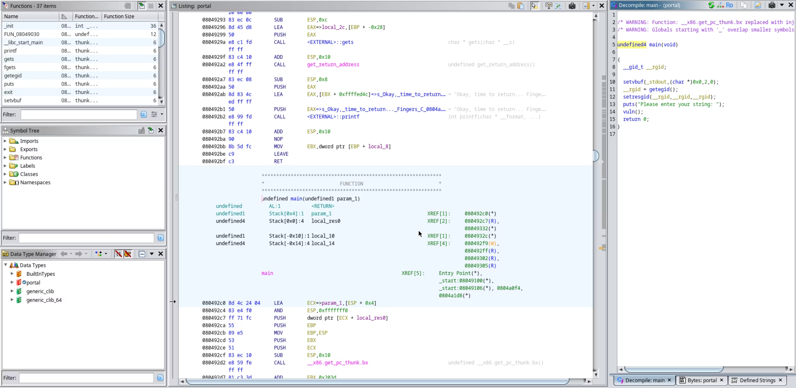
Step 2: Reverse Engineering
Open the firmware files in reverse engineering tools like Ghidra to analyze the code structure, uncover hard-coded credentials, or identify exploitable functions.The AccuVote-TS firmware contained hard-coded administrative access, allowing anyone with the PCMCIA to alter vote calculation processes.

Slide 7



Step 2.2: Reverse Engineering
Editing Firmware:
Modify the firmware code to include new instructions, such as changing vote tallies or altering interface settings to favor a specific candidate.
Example: When vote entered for Candidate A, the code would normally add something to a variable representing that candidate. Change that so that the vote is added to Candidate B instead.
Optional: Insert Backdoor
Introduce a backdoor to allow remote access to the machine or to run additional unauthorized code on the machine during election day.
Can be done by installing a preinstalled rootkit or carefully modifying system files to allow for undetected alteration of the code.

Slide 8
Step 3: Re-uploading Modified Firmware
Place the modified memory card back into the AccuVote-TS slot. The machine automatically reads from the card on startup, applying any changes made.
On reboot, the machine reads and executes the modified firmware, now allowing the machine to operate according to the attacker’s specifications.
(This is also a bad practice. The machine SHOULD check for validity of data before applying changes using hashing, but noone hires geniuses to build voting machines.

Slide 9

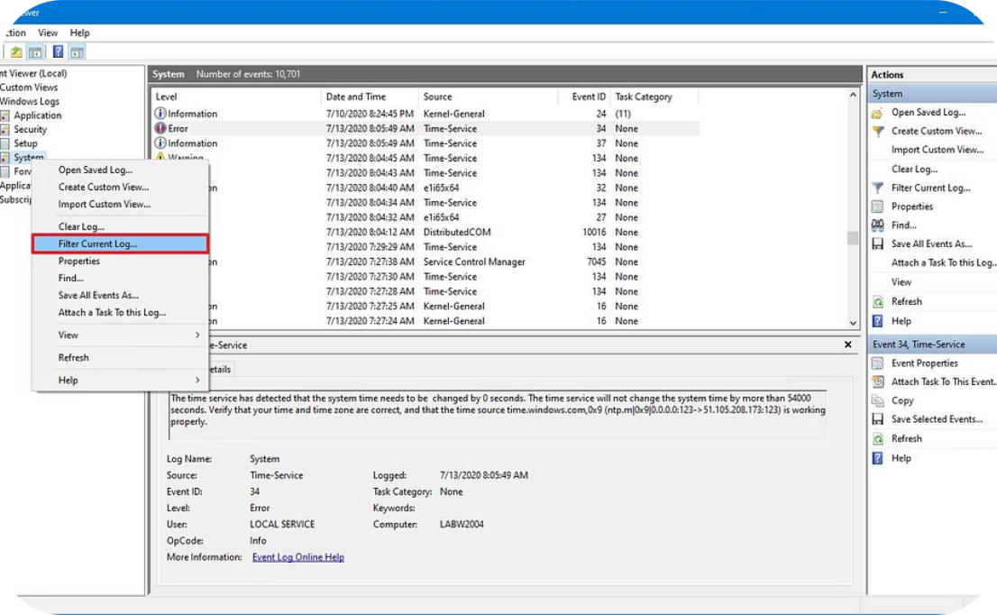

Covering Tracks
Self-Deleting Malware
Log File Deletion:
Resetting Firmware to Default:
Write malware that automatically deletes itself after execution, minimizing traces of tampering.
Modify log files stored on the memory card to erase evidence of firmware or vote count changes.
After completing the manipulation, reset the firmware to its original state, making it more difficult for investigators to identify unauthorized modifications.
C\Windows\System32\winevt\Logs
save a state of untampered OS snapshot, then revert to that state.
can be done with simple if clauses
can be easily done using a tool like Timeshift

Slide 10

A Different Approach
Exploiting Weak Software and Network Security for Manipulation
Operating System Weakness:
Diebold AccuVote-TS runs a highly outdated version of Windows CE
Weak Login Auth
The machine often uses a simple PIN system or easily guessed admin password for authorized access
Networked Machines:
Diebold AccuVote-TS machines are networked between each other (sometimes) allowing for interception of data.

Slide 11

Real-World Examples of Voting Machine tampering:
1
2018 Georgia Voting System Breach:
Unauthorized individuals accessed Georgia’s voting machines. They were able to copy software, creating the possibility of reverse engineering or tampering with machine code.
2
A 2020 @ Uni of Michigan
Highlighted flaws in the iVotronic’s software, possibly saving future voting tampering.
3
DEF CON Voting Village Findings:
Since 2017, DEF CON Voting Village has allowed cybersecurity experts to test real voting machines. Findings have shown flaws in models like the Diebold AccuVote, ES&S iVotronic, and Dominion machines.
In DEF CON Voting Village, Dominion machines were found to have weak login credentials and poor network segmentation, making them susceptible to unauthorized network access.

Slide 12



Research Centers and Government Initiatives:
National Institute of Standards and Technology (NIST)
DEFCON and CISA
Current Reforms:
Share findings and suggest improvements for state and federal election systems.
Increased investment in open-source voting technology to ensure transparency.
Provides guidelines for secure voting technologies and has published a framework for evaluating voting machine security.
Deployment of end-to-end encryption on all voting machines.

Slide 13

Thank You!

